Slide 1


2026 Introduction of
DONGWON CNS EDU
555, Dunchon-daero, Junwon-gu, Seongnam-si, Gyeonggi-do, Korea
DONGWON CNS EDU INC.
TEL. 82-31-733-5274 / FAX. 82-31-732-8503 / www.dwcnsedu.co.kr
© 2025 Dongwoncnsedu. ALL RIGHTS RESERVED.

Slide 2

Contents
01/ Company Introduction
02/ Products

Slide 3
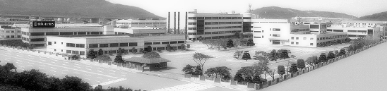
1. Company Introduction
Brief Information
Company Name | Dongwon CNS Edu. Corp. | President & C.E.O. | Choi, MoonSUK
Business Field | Educational Equipments, MicroScope,Telescopes, Computers and Peripherals, System Integrity, etc
Address | 555, Sangdaewon-dong, Jungwon-gu Seongnam-si, Gyeonggi-do, Korea
Contact Point | Tel : +82-31-733-5274 / Fax : +82-31-732-8501
Foundation Date | 2011
Business Period | Nov. 1977 ~ Current
Annual Turnover | KRW 40 Bil
Employees | 15 persons
Creation & Passion & Challenge

Slide 4
History
1. Company Introduction
Dongwon Systems Corp. is the history of Education Equipment.
1970
1977 Founded
1981 Awarded President’s price for export merit
1984 Acquired KS Mark on Microscope
1989 Acquired Q Mark on Microscope
Acquired Q Mark on Camera (P-50, PC35AFM-SE, PINO35S)
Started the production of Lens for CCTV camera
1980
HISTORY
1990
1992 Started to launch telescope (DA-350, DA-1500)
1994 Started to launch the OHP (DOP Series)
1997 Stared to launch Visual Projector
1998 Acquired ISO 9001
HISTORY
2000 Started to launch Dongwon LCD Projector
2001 Visual Projector selected Korean Millennium Product and awarded Industry
Design Prize
2007 Awarded Excellence at 1st E-Learning Contest in 2007
2008 Awarded Top Prize at 2nd E-Learning Contest in 2008
2011.01 DongWon CNS Edㅇu corp. Spin off
2014 Acquired ISO 9001, 2008 certification
2017 Microscope and 25 other species PPS registration
2019 MOU agreement with sperm analyzer manufacturer
2022 University of Rwanda Polarized Microscope Export
2024 University of Ghana's Microscope Export
2000
HISTORY

Slide 5





1. Company Introduction
Domestic
Production
Technology
/ Excellent
Product
Speedy
A/S
Preventive
Maintenance

Slide 6


01
회사 소개
Education
Safety
Enviroment
MicroScope
Safety film
Eco Clean Mat
Electronic Board
Book sterilizer
Safety goods storage box
3D Printer
Non-slip

Slide 7
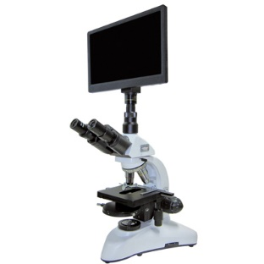
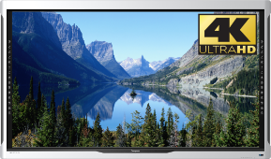
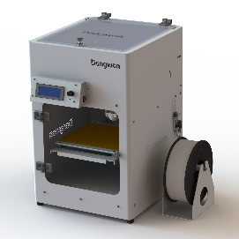
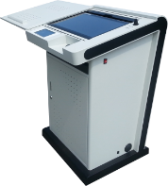
02
Education Items
제품 소개
Microscope
Electronic board
3D Printer
■ Stereo Microscope
■ Bio Microscope
■ Polarizing Microscope
■ metal microscope
■ Multimedia Imaging
Microscope
■ monitor-type microscope
■ 86-inch UHD
Electronic board
■ DTB Ser.
■ D3D-203
■ D3D-303

Slide 8
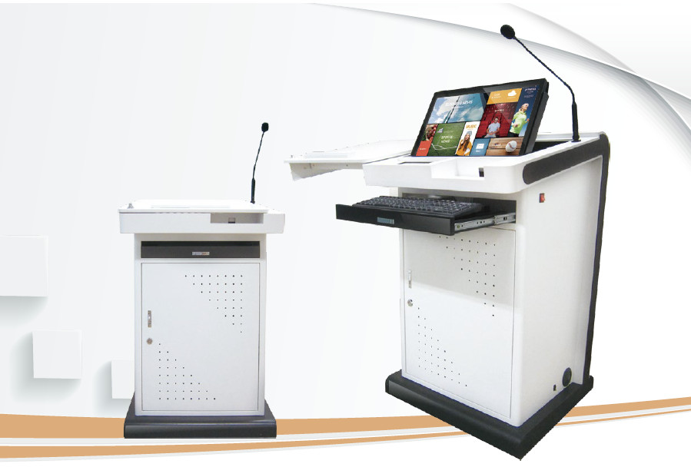
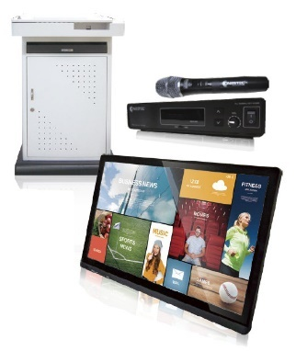
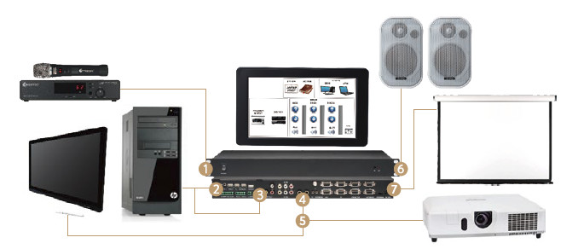
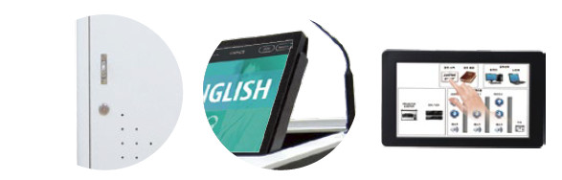
02
Education Items – electronic desk
제품 소개
DTB - Series
■11 different models for customized use
- 22-inch tablet monitor
- Amp Integrated Controller
- Goose neck microphone, wireless microphone provided
- Provides a variety of functions for utilizing and progressing
educational content a writing program
■ Provides quick and precise touch (electronic pen, hand touch)
■ Durable durability and ergonomic design
■ Provide convenient lecture preparation with one-touch start/end
of lecture
■ convenient control system
[Integrated Controller System]
Damage and theft prevention
Adjusting the angle
7-inch controller pad

Slide 9

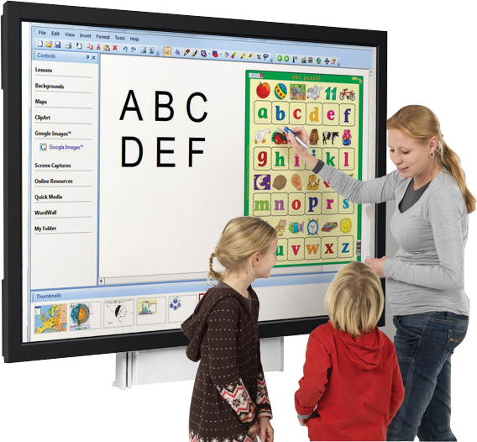



02
Education Items - Electronic Board
제품 소개
Diverse sense of touch & Multi touch
Use anything to touch and interact with the display
with supporting 10 points multi touch
The best picture / video quality
Realizing 4K(UHD) resolutions and 60Hz Refresh rate
Multiple easy cables connection
To cable boxes, Video, Audio, USB, MiniPC and other devices
Long terms usages
Without replacing any kinds of consumables, long terms
life time with LED back light up to 60,000hrs

Slide 10

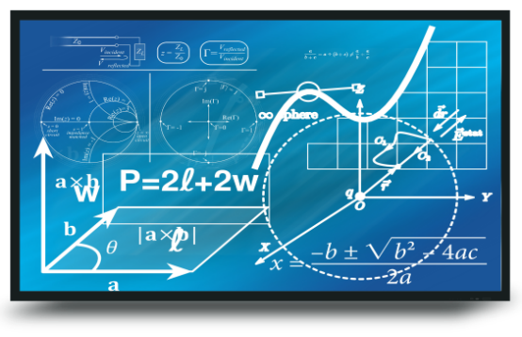

02
Education Items – Electronic Board
제품 소개
86 inch Interactive LED Board
features
Equipped with 4 indicators lamps for checking the problem of monitor at real time
With USB & HDMI ports on the front bezel, providing users with the most easiness to connect to
memory, mouse, keyboards and any kinds of external video devices
With RMS module, users can control customized functions by wireless
Compatible with OPS PC
Realizing clean images and video with UHD resolution
Specification
Model | BR-I86UD
Screen Size | 86 Inch
Max. Resolution | 3840 x 2160 (4K UHD)
Brightness | 410cd / m²
Touch | Infrared, 10 points, fingers or any solid object
Response Time | 15ms (Typ.)
Connectivity | HDMI x 3 (1.4), VGA x 1, CVBS+Audio x 1, Stereo In x 1, SPDIF x 1, USB Touch x 1, RS-232 x 1
Dimensions | 1977 x 1148 x 102 mm
Weight | 105 kg
Indicator lamps
USB & HDMI Ports

Slide 11
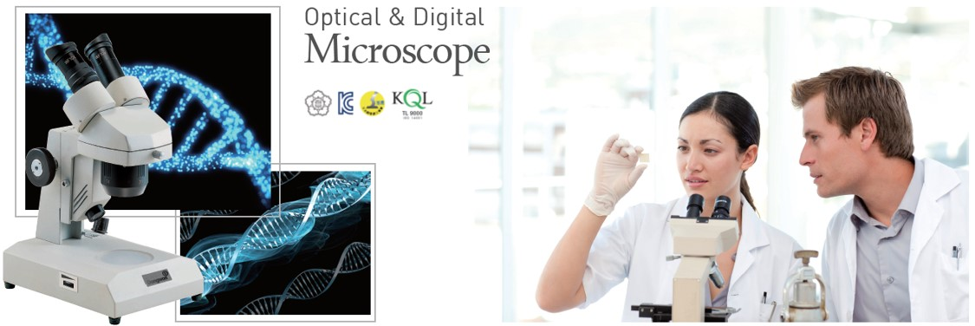
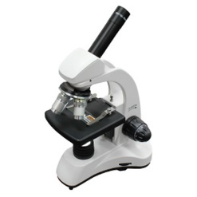
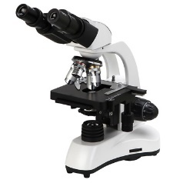
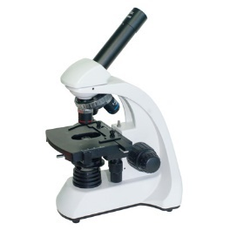
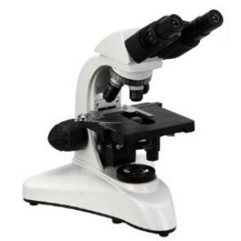
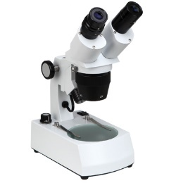
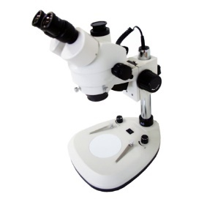
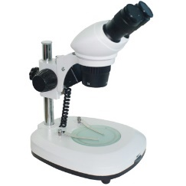
02
Education Items – Microscope
제품 소개
Biological
Microscope
EL-S/R Ser.
Monocular head
40~1,500X
Cordless operation (EL-R Ser.)
LED Illumination
EL-B Ser.
Binocular head
40~1,500X
Mechanical stage
Cordless operation
LED Illumination
Since 1977
EL-RM Ser.
Monocular head
40~1,500X
Mechanical stage
Cordless operation (DEM-R Ser.)
LED Illumination
ELB-1000/1600
Binocular head
40~1,600X
Mechanical stage
LED Illumination
Stereo
Microscope
ELS-S/R Ser.
Binocular head
10~60X
Cordless operation (ELS-R Ser.)
Halogen/LED Illumination
ELS-7045
Binocular head
Both eyepieces have ±5 diopter adjustments
Zoom Stereo 7~45X
LED Illumination
ELS-SN/RN Ser.
Binocular head
10~60X
Cordless operation (ELS-RN Ser.)
LED Illumination

Slide 12
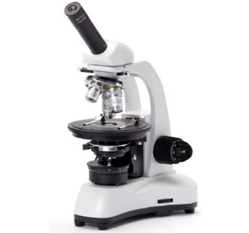
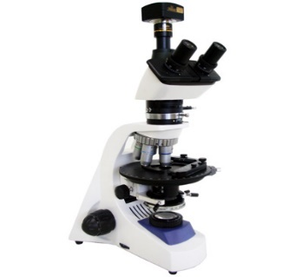
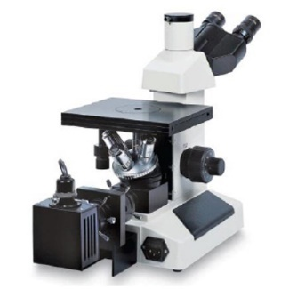
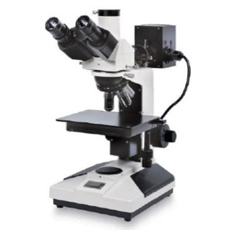
02
Education Items – Microscope
제품 소개
Polarization
Microscope
Since 1977
EL-P400
Monocular head
40~400X
Rotary stage Φ 135mm
N.A. 1.25 Abbe condenser
Halogen lamp
ELP-630
Trinocular head
40~630X
Rotary stage Φ 172mm
Swing type N.A. 1.25 Abbe condenser
3.1 Mega pixels CMOS camera
LED Illumination
Metallographic
Microscope
ELM-IT
ELM-UT
Trinocular, Inclination of 30 degree, Left eyepieces with ±5 diopter adjustments
WF10X(DIN), FN18mm
Plan achromatic objectives with long working distance (no cover glass)
5X, 10X, 40X, 60X(Spring)
Double layer mechanical stage
3.1 Mega pixels CMOS camera
6V 20W halogen lamp, adjustable brightness

Slide 13
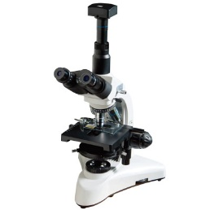
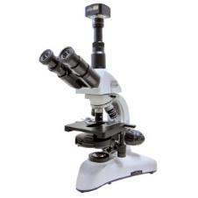
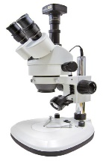
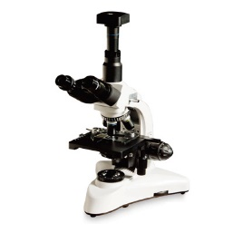
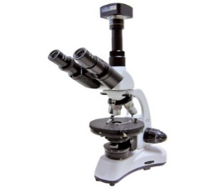
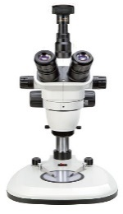
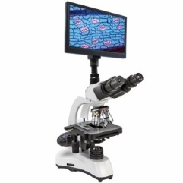
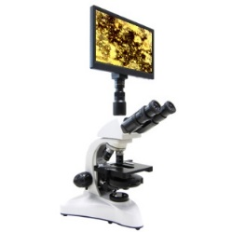
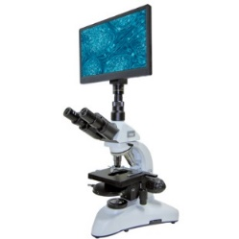
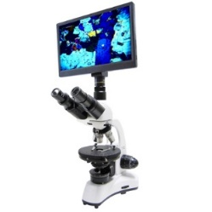
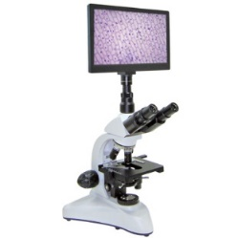
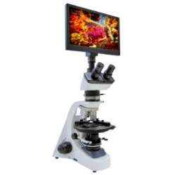
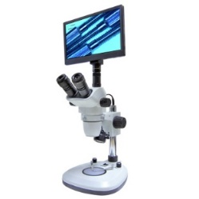
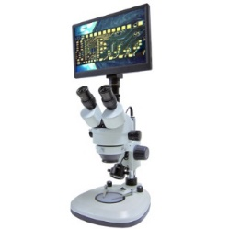
02
Education Items – Microscope
제품 소개
Digital
Microscope
3.1 Mega pixels CMOS camera
ELP-1600
Phase constrast Microscope
Trinocular head
40~1,600X
Mechanical stage
LED Illumination
ELP-1000i
Phase constrast Microscope
Trinocular head
40~1,000X
Mechanical stage
LED Illumination
ELS-7045T
Binocular head
Both eyepieces have ±5 diopter adjustments
Zoom Stereo 7~45X
LED Illumination
Since 1977
ELT-1600
Trinocular head
40~1600X
Mechanical stage
LED Illumination
ELP-400
Monocular head
40~400X
Rotary stage Φ 135mm
Halogen lamp
ELT-6555
Binocular head
Both eyepieces have ±5
diopter adjustments
Zoom Stereo 6.5~55X
LED Illumination
Monitor
Microscope
11.6 inch
Full HD LCD
2.0 Mega Pixels
EL-M Ser.
ELP-1600M
ELP-1000iM
ELP-400M
ELT-1600M
ELP-630M
ELT-6555M
ELT-7045M

Slide 14
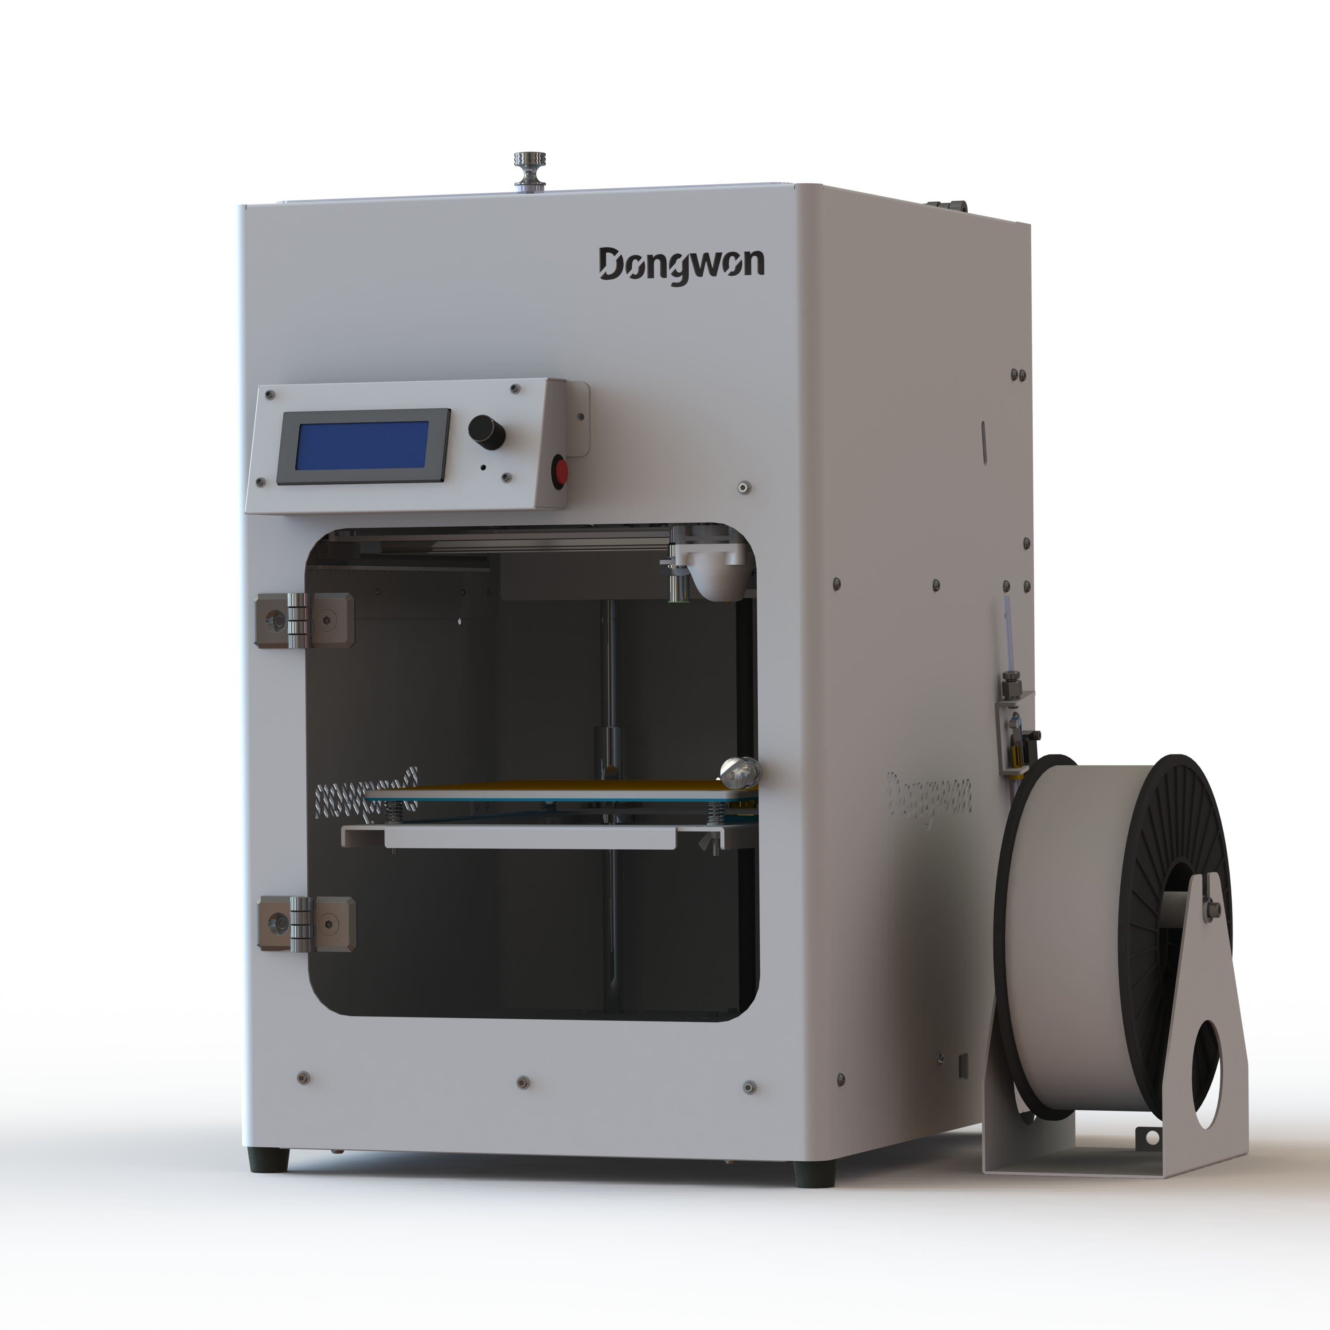
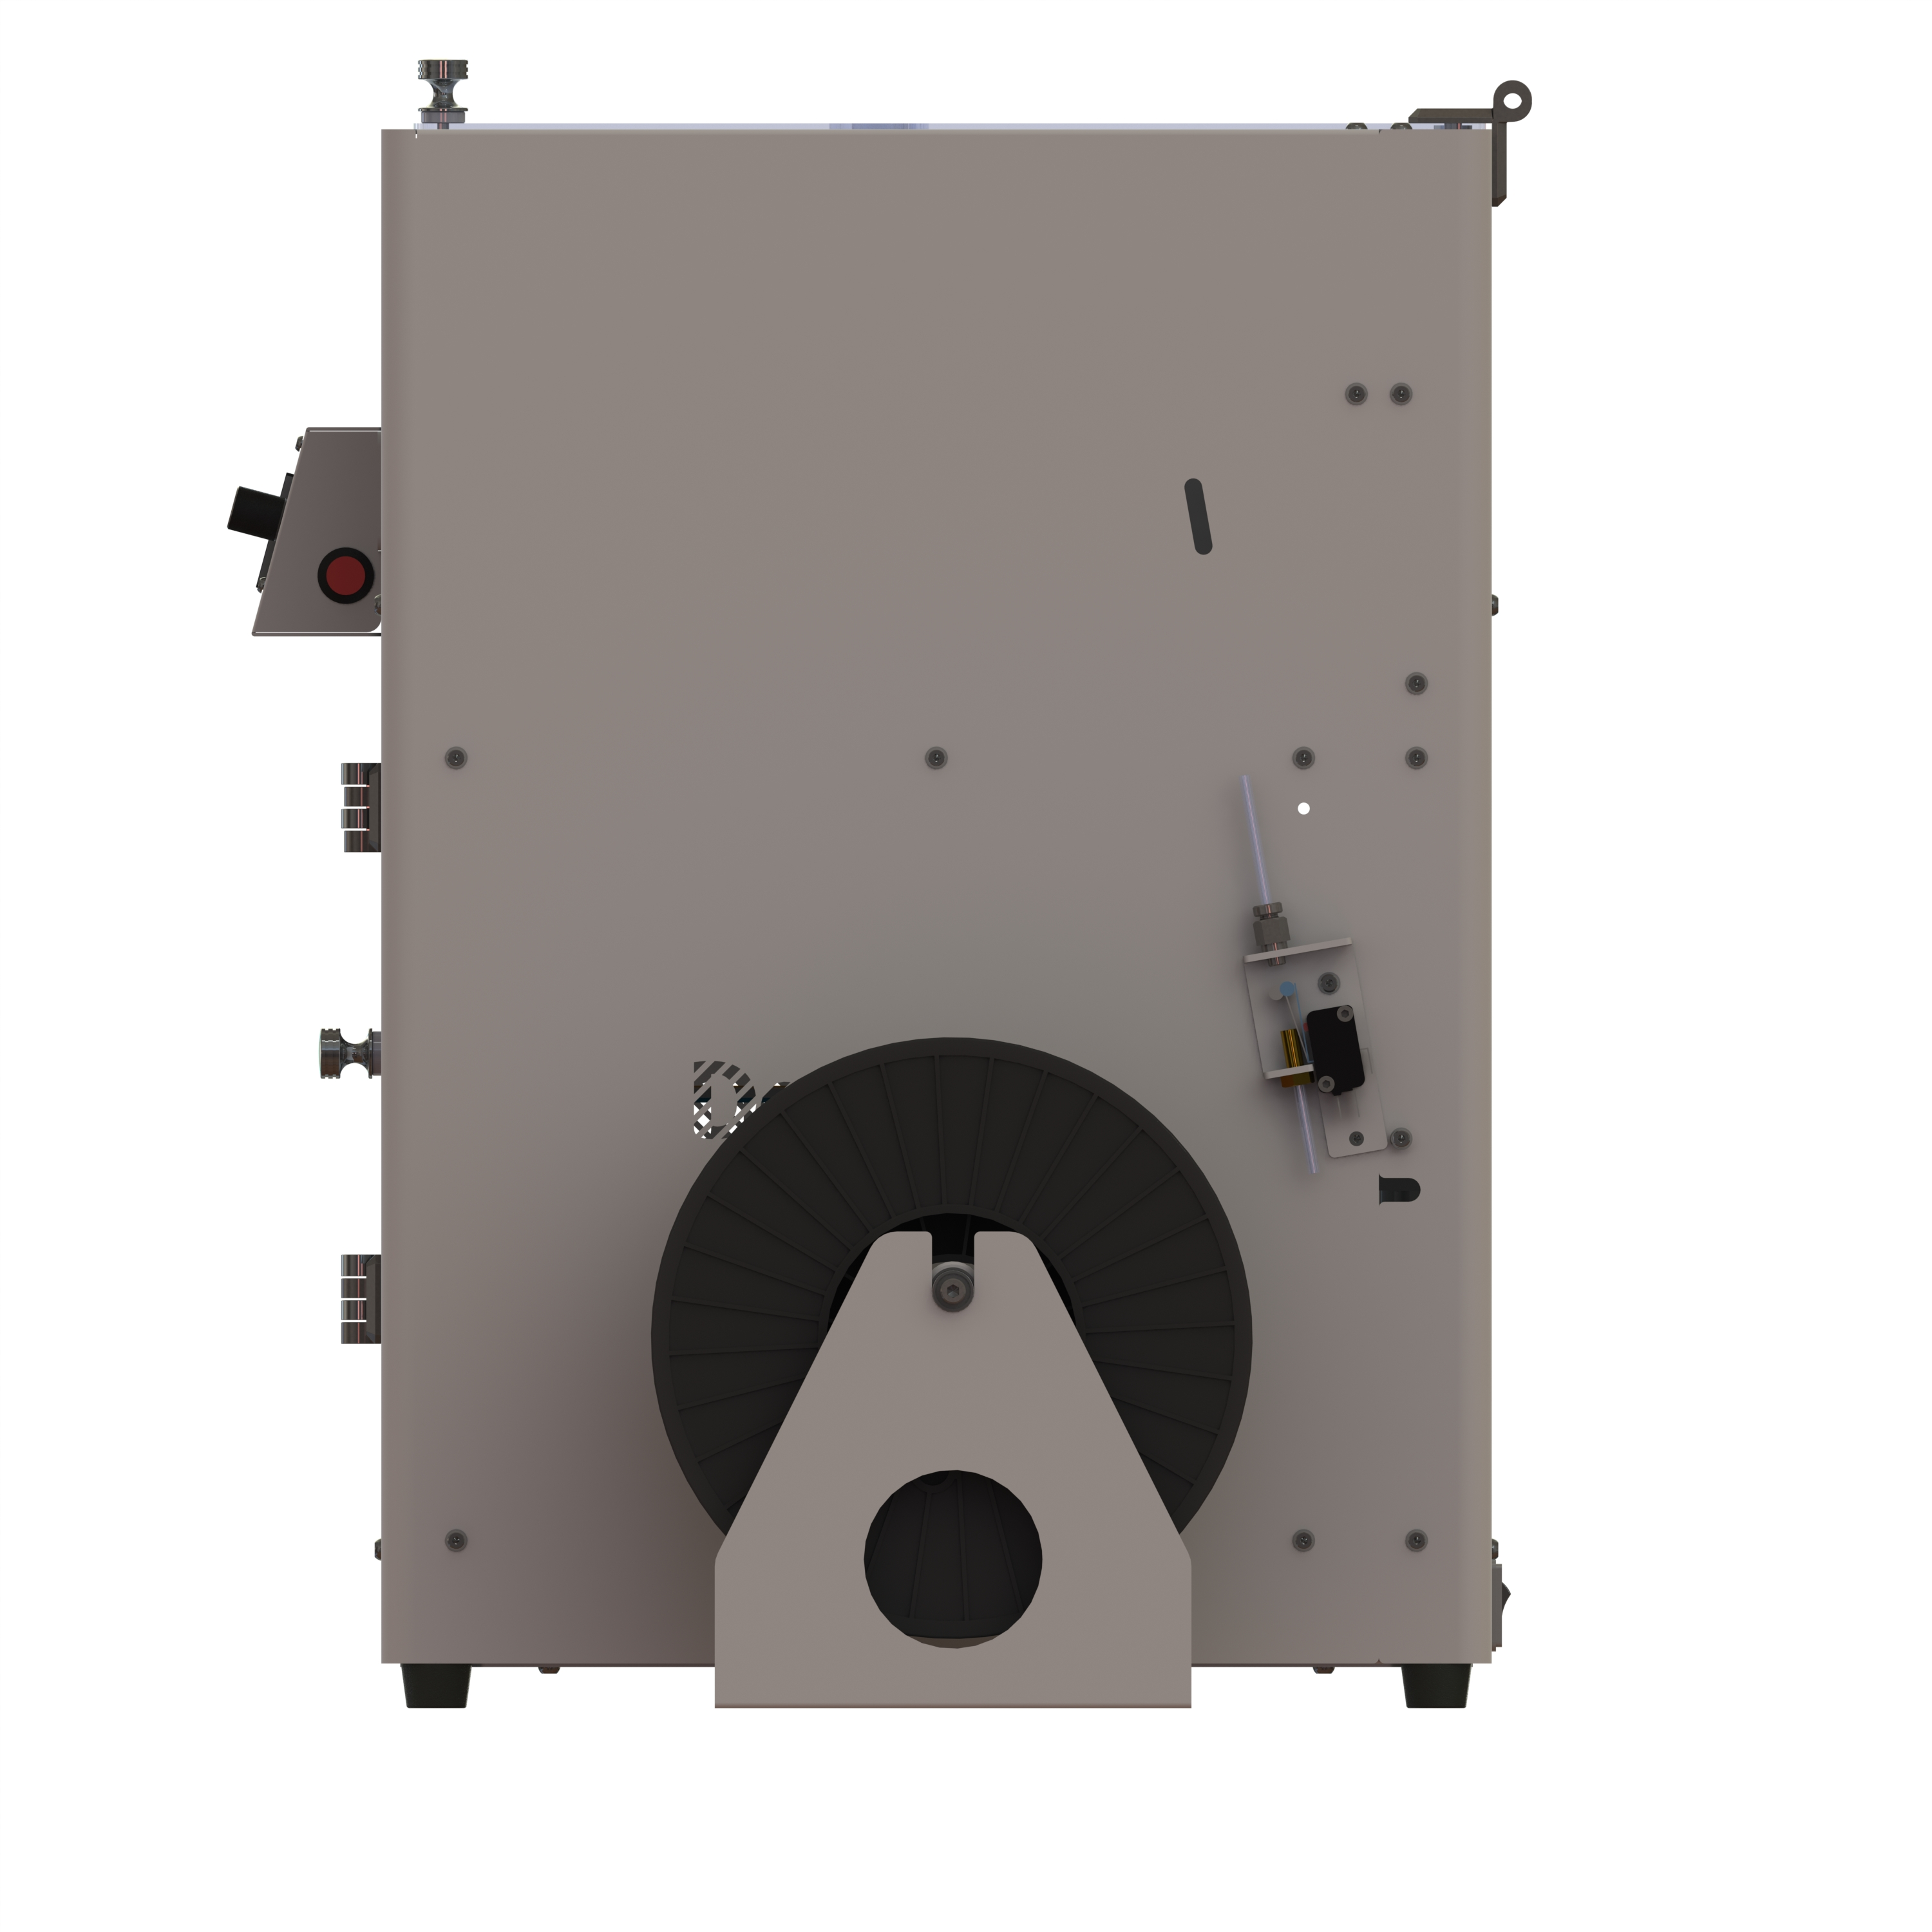
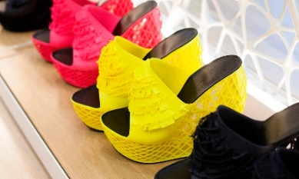
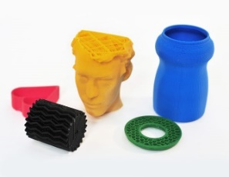
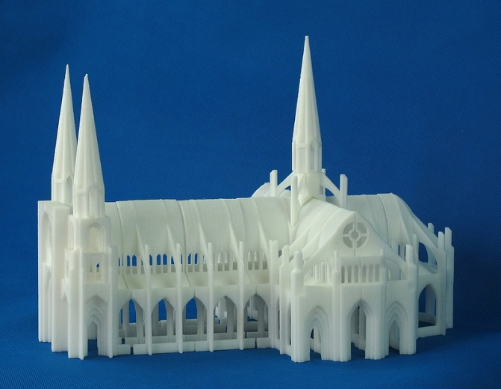
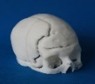
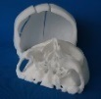
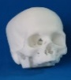
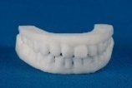
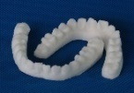
02
Education Items – 3D Printer
제품 소개
모델명 | D3D-203 / D3D-303
프린트 방식 | FDM (Fused Deposition Modeling) / Thermoplastic extrusion / coreXY mechanism/ Auto Leveling /긴급정지 버튼
조형물 크기 | D3D-203 : 203(x) X 203(y) X 203(z)mm D3D-203 : 303(x) X 303(y) X 303(z)mm
인쇄 속도 | 최대 300 mm/sec
연결 | USB, SD-CARD(32G지원-FAT32)
필라멘트 직경 | 1.75 mm / 필라멘트잔량체크센서
노즐 직경 | 0.4 mm
적층(layer) 두께 | 0.01 - 0.3 mm
위치 정밀도 | Z : 0.001 mm | XY : 0.02 mm
필라멘트 | ABS, PLA, PVA, PCL, HDPE, PP, PMMA
편의사양 | Auto Leveling /긴급정지 버튼/ 필라멘트잔량체크센서
전원 | 입력 전원 | AC90~132V / AC180~264V , 50/60 Hz
 | 내부 전원 | 24V, 16A, 400watts
소프트웨어 | 제어 프로그램 | Cura for makers , pronterface .....
 | 운영 체제 | Windows, OS X, Linux
 | 입력 파일 타입 | STL, OBJ, Gcode
사이즈/중량 | 크기(본체) | 343 x 530 x 372mm (W x H x D)
 | 제품 중량 | 15Kg
◆ Application area
Toy & Animation
Education
Art & Architecture & Design
Consumer Product
Medical Industry etc.

Slide 15

Dongwon C&S Edu, based on 40 years of technology and know-how, grows together with its customers through customer satisfaction, customer trust, and customer engagement. We are also developing AI digital microscopes and supplying them worldwide.
Thank you.

